Slide 1
XGBoost
eXtreme Gradient Boosting
Ensemble learning method
Custom tree building algorithm

Slide 2
Supports regression and classification
Provides parallel tree boosting
Uses a gradient descent optimization technique

Slide 3

Can handle missing values automatically
Tree pruning: results in deeper, but optimized trees
Incremental training

Slide 4
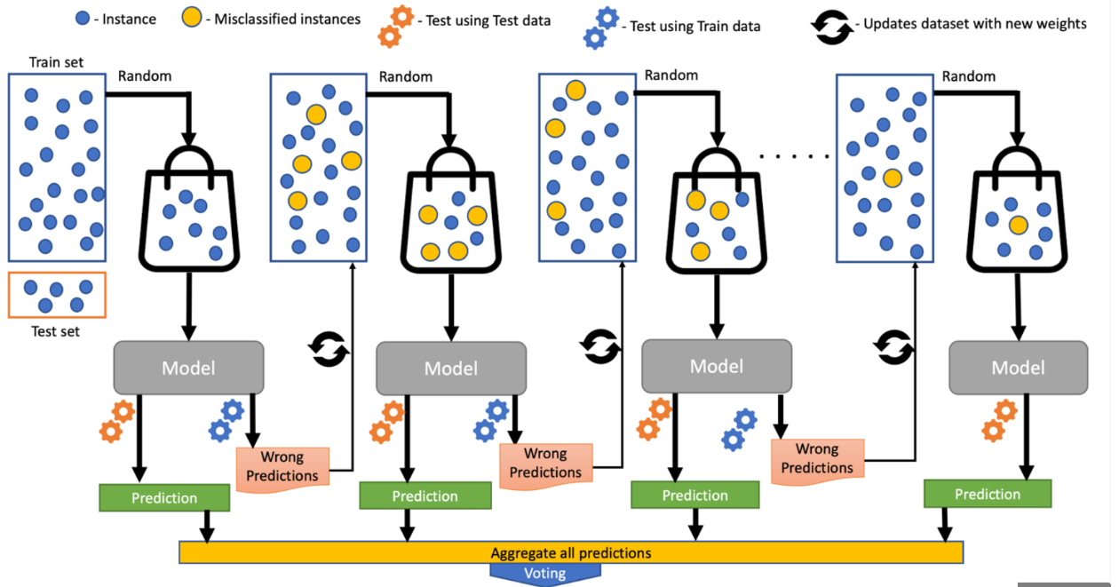

Slide 5
Pros | Cons
High accuracy | Overfitting
Speed | Memory usage
Flexibility | Lack of transparency

